Slide 1


CHITKARA UNIVERSITY
Semester – iv
Python Project
Submitted To : | Dr. Tushar
Submitted By : | Gursimran kaur

Slide 2
--: TABLE OF CONTENTS :--
TOPIC ..……………………………………………………………………………………3
PROJECT REPORT ..………………………………………………………………………5
Introduction to the project …………………………………………………… 6
Tool Box In Python ……………………………………………………………7
Module in python …………………………………………………………… 14
Closing Statement …….………………………………………...……………………… 18

Slide 3
TOPIC
TOOL BOX

Slide 4
Project Report

Slide 5
…. INTRODUCTION TO THE PROJECT ….
THIS PROJECT IS BASED ON A PROGRAMMED UTILITY TOOL BOX.
THIS TOOL BOX CONTAINS THE FOLLOWING FUNCTIONS :--
BMI CALCULATOR
TEMPERATURE CONVERTER
AGE CALCULATOR
CALENDER
RANDOM DICE ROLLER
ARITHMETIC CALCULATOR
RANDOM PASSWORD GENERATOR

Slide 6
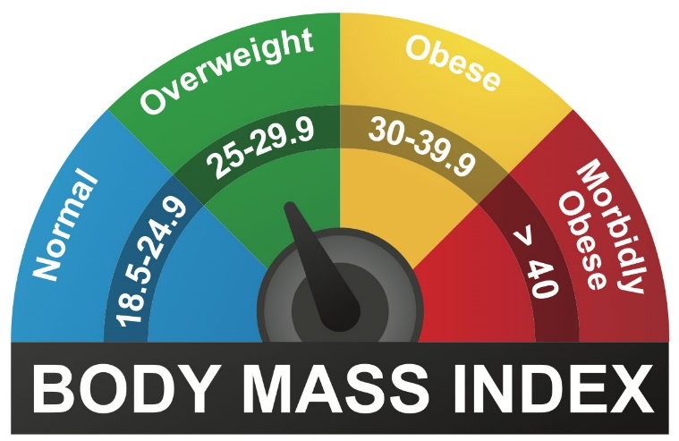
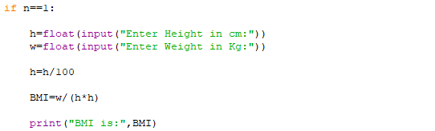
BMI CALCULATOr
Body mass index (BMI) is a measure of body fat based on height and weight that applies to adult men and women.
Body mass index is a value derived from the mass and height of a person.
The BMI is defined as the body mass divided by the square of the body height, and is expressed in units of kg/m²,
resulting from mass in kilograms and height in metres.

Slide 7

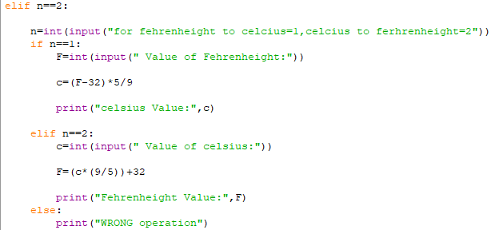
TEMPERATURE CONVERTER
A temperature converter helps in the conversion of the measurement units of the temperature recorded in a
particular unit. Temperature expresses the degree of heat or cold of a solid, liquid, or gas.
Temperature is measured using a thermometer. While Kelvin (K) is the SI unit of temperature, people generally
use Centigrade or Celsius (°C) and Fahrenheit (°F) to measure temperature.

Slide 8
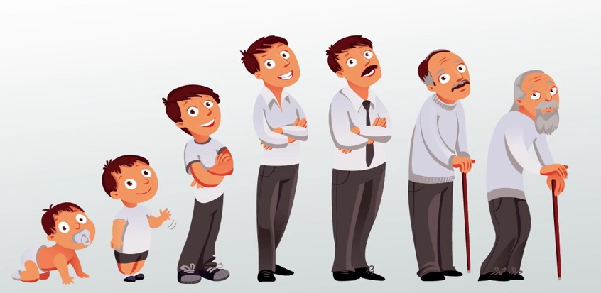
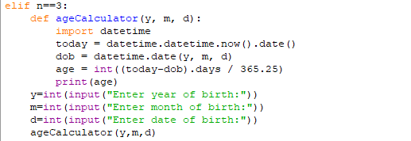
AGE CALCULATOR
The age of a person can be counted differently in different cultures.
This calculator is based on the most common age system. In this system, age grows at the birthday.
For example, the age of a person that has lived for 3 years and 11 months is 3 and the age will
turn to 4 at his/her next birthday one month later. Most western countries use this age system.

Slide 9

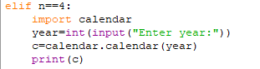
CALENDER
A calendar is a system of organizing days. This is done by giving names to periods of time, typically days,
weeks, months and years. A date is the designation of a single, specific day within such a system.
A calendar is also a physical record (often paper) of such a system. A calendar can also mean a list of planned
events, such as a court calendar or a partly or fully chronological list of documents, such as a calendar of wills.

Slide 10
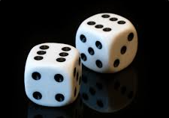
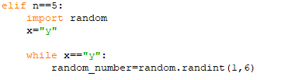
RANDOM DICE ROLLER
Dice (singular die or dice) are small, throwable objects with marked sides that can rest in multiple positions. They are used for generating random values, commonly as part of tabletop games, including dice games, board games, role-playing games, and games of chance.

Slide 11
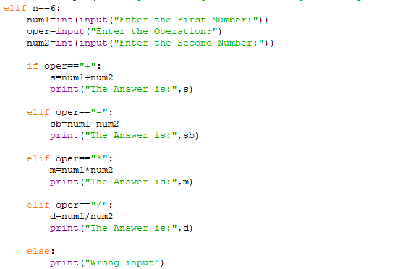
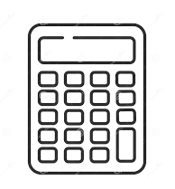
ARITHMETIC CALCULATOR
Arithmetic is an elementary part of mathematics that consists of the study of the properties of the traditional operations on numbers—addition, subtraction, multiplication, division, exponentiation, and extraction of roots.
CALC

Slide 12

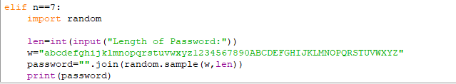
RANDOM PASSWORD GENERATOR
Having a weak password is not good for a system that demands high confidentiality and security of user credentials. It turns out that people find it difficult to make up a strong password that is strong enough to prevent unauthorized users from memorizing it.
The components of the password are represented in the form of arrays.
Use the random method to select at least one character from each array of characters.

Slide 13
MODULEs USED IN THIS programmed tool box

Slide 14
: RANDOM MODULE :
Python Random module is an in-built module of Python which is used to generate random numbers.
These are pseudo-random numbers means these are not truly random.
This module can be used to perform random actions such as generating random numbers, print random a value for a list or string, etc.

Slide 15
DATETIME MODULE :
In Python, date and time are not a data type of their own, but a module named datetime can be imported to work with the date as well as time.
Python Datetime module supplies classes to work with date and time.
These classes provide a number of functions to deal with dates, times and time intervals. Date and datetime are an object in Python, so when you manipulate them, you are actually manipulating objects and not string or timestamps.

Slide 16
CALENDER MODULE
Python defines an inbuilt module calendar that handles operations related to the calendar.
The calendar module allows output calendars like the program and provides additional useful functions related to the calendar.
Functions and classes defined in the Calendar module use an idealized calendar, the current Gregorian calendar extended indefinitely in both directions. By default, these calendars have Monday as the first day of the week, and Sunday as the last (the European convention).

Slide 17
THANK YOU

